Slide 1
Usage Tutorial
Team SoftMax

Slide 2
Project introduction
Goal: Compare the performance between Generative Entity Retrieval(GENRE) and Elasticsearch
Python documentation as the knowledge base
StackOverflow data for questions and golden answers
Reciprocal rank for measure search performance

Slide 3
Implemented Structure
Setup and install
ElasticSearch
GENRE
Development
Crawl data from the Python reference doc
Crawl data from the StackOverflow
Query questions from the StackOverflow and retrieve the reciprocal rank
Query dataset
Retrieval Engine
Dataset for ElasticSearch import
(reference_doc_import.json)
Training dataset
StackOverflow
ElasticSearch
on Windows Azure
(13.82.107.120:9200)
Bulk
Import
Language reference documentation
(https://docs.python.org/3)
Crawl
Index
StackOverflow-entries.py
Using StackOverflow API
Query question
Index
Text
Text
Title
Crawl
Title
Doc URL
scraper-reference.py
Using Selenum, and BeautifulSoup
ElasticSearch_query.py
Using Python Elasticsearch Client and matplotlib library
Doc URL
Reformat
Crawled Dataset
(StackOverflow-entries.json)
Doc URL
response
ElasticSearch_
Import.py
Match
doc URL rank
GENRE
Crawled Dataset
(reference_doc.json)
question
answer
Reciprocal
Rankset and distribution histogram
Text
Reference-link
Title
Doc URL

Slide 4
Software Usage
Basically, Python script execution to access web page and the ElasticSearch
Requirements
Python IDE (e.g., VS Code or PyCharm) to execute codes
Python 3.5.4 (other versions were not tested)
Internet-connected environment, port 9200 should be accessible

Slide 5
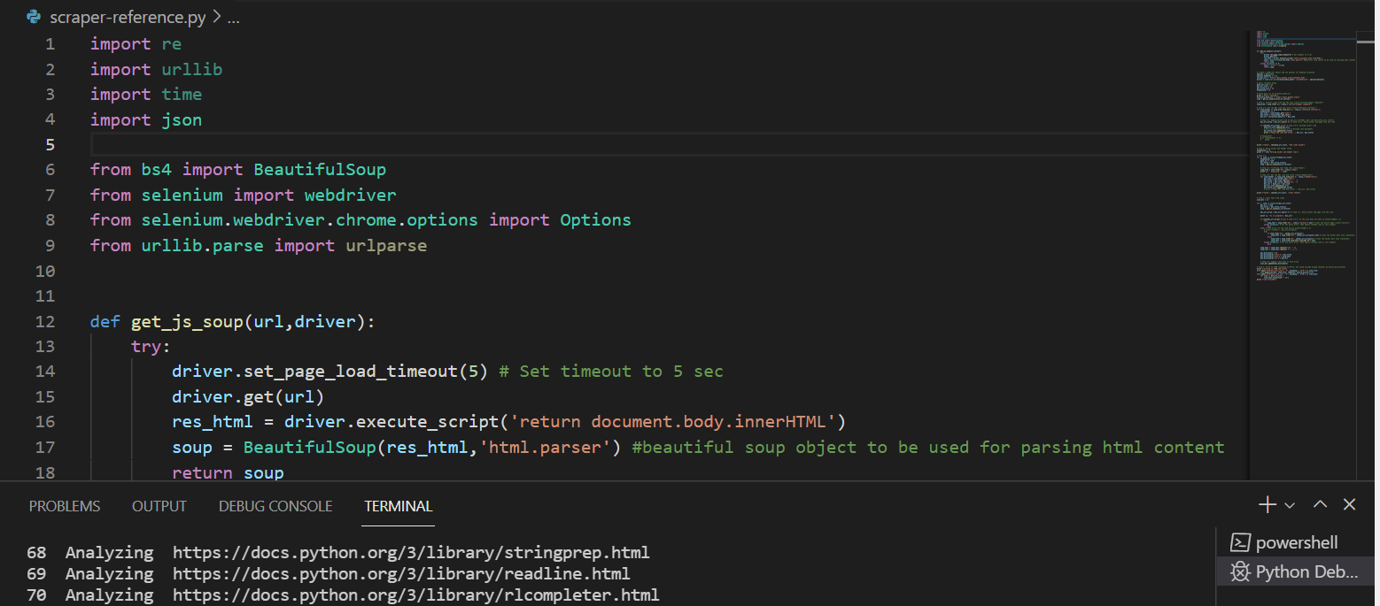
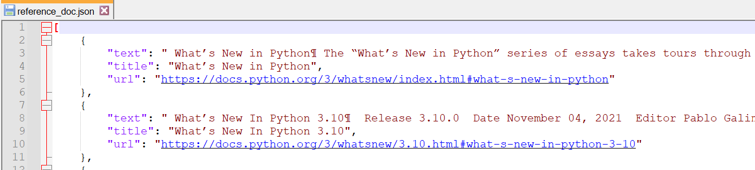
Crawl data from the Python reference
How to execute
Open scraper-reference.py in IDE and execute
Please check reference_doc.json is correctly created after execution.
Please make sure
Machine is connected to Internet
Chrome is installed
BS4, Selenium library is installed

Slide 6
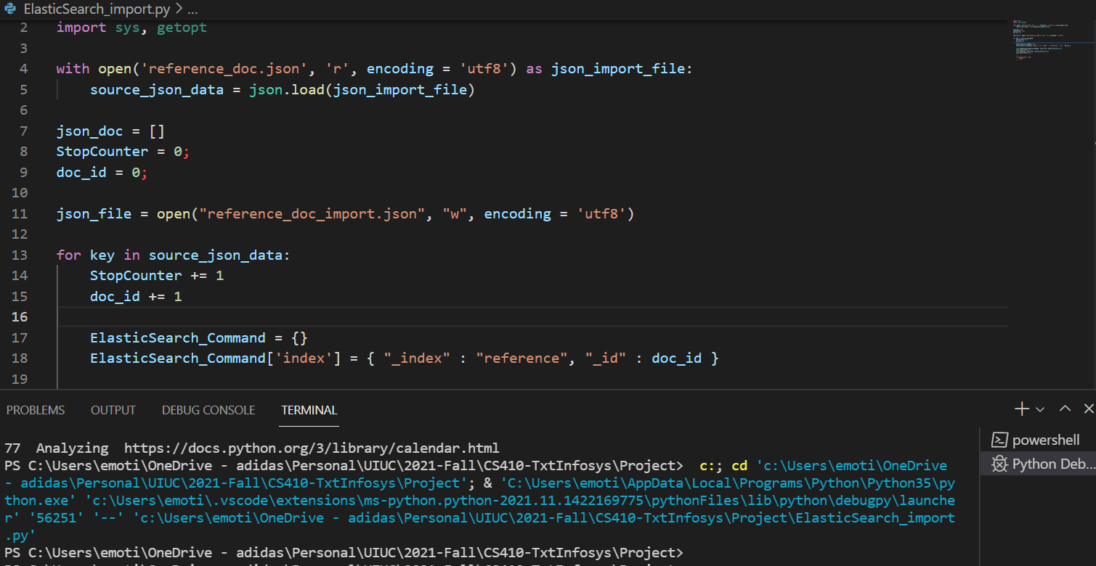
Data import to the ElasticSearch
How to execute
Please make sure reference_doc.json exists
Open ElasticSearch_import.py in IDE and execute
Please check reference_doc_import.json is correctly created after execution.
Then, execute below command in command prompt
curl -X POST "13.82.107.120:9200/reference/_bulk?pretty" -H "Content-Type: application/json" --data-binary @reference_doc_import.json

Slide 7
Crawl data from the StackOverflow
Please fill out!

Slide 8
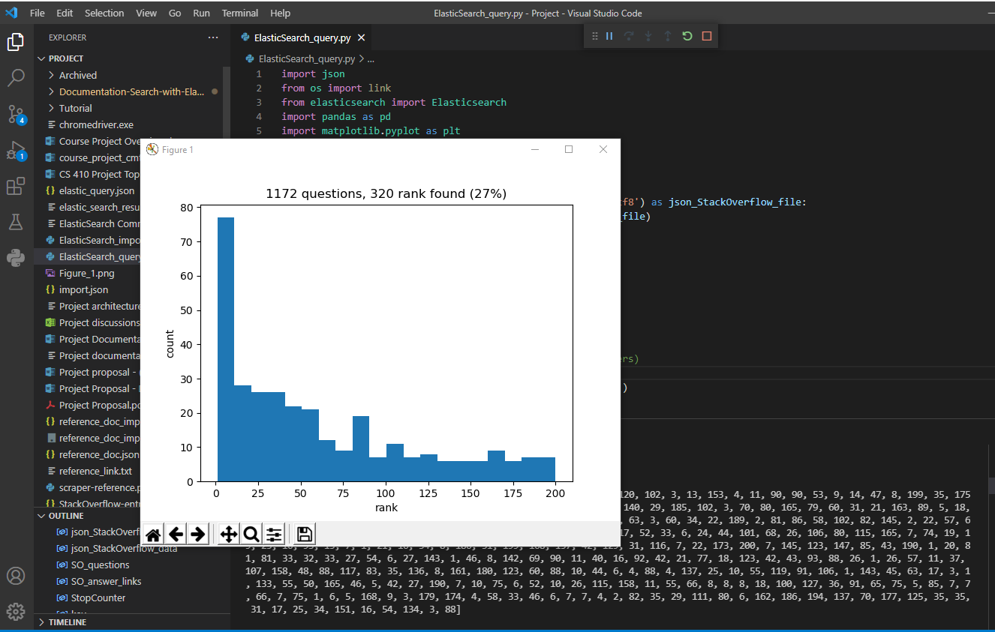
Query and Reciprocal rank
How to execute
Open ElasticSearch_query.py in IDE and execute
After execution, histogram and the reciprocal rank data will be displayed
Please make sure
The ElasticSearch is accessible from the machine (13.82.107.120 port 9200)
ElasticSearch library is installed
StackOverflow-entries.json exists

